Slide 1
Learning and development in the social interaction: fruitful history and future directions
Aleksandar Baucal
Dept. of Psychology, University of Belgrade, Serbia
https://www.researchgate.net/profile/Aleksandar-Baucal
EARLI SIG 10, 21 & 25 Conference 2024
Walking the Talk: Co-constructing the politics of meaning, diversity and learning
Bari, Italy
This research was supported by the Science Fund of the Republic of Serbia, Grant No. 7744729, The PEER Model of Collaborative Problem Solving: Developing Young People’s Capacities for Constructive Interaction and Teamwork – PEERSolvers

Slide 2
What am I puzzled with?
Under what conditions and in what way…
… learning and development …
…could emerge during a situated collaboration with others?

Slide 3
Why is it so interesting to me?
Theoretical relevance (individual vs sociocultural approaches to human development)
Methodological relevance (interaction as a topic and as a tool, quantitative and qualitative approach)
Practical relevance for the education
Social relevance (ensuring social participation of excluded, marginalized, segregated, discriminated…equal opportunities for all)
Political relevance (dialogue in the time of polarizations)
Cultural relevance in the time of cultural wars
Relevance for globalized world with intensive migrations

Slide 4
It seems like a promising field of inquiry
At the beginning, there were many open questions with a hope that they will be clarified based on research studies
It seems just as a matter of time and several studies to get good answers, but…

Slide 5
It turned out into a never-ending story

Slide 6
Historical perspective
Piaget vs Vygotsky: peer interaction (symmetric and asymmetric) and adult-child interaction
Parent-child interaction at home and during participation in socially and culturally relevant practices
Adult-child and child-child interaction embedded into socio-culturally relevant practices
Classroom interaction (teachers-students, students-students)
Project based learning and problem-based learning as an educational practices
Technological turn (CSCL and interaction via digital technologies)
Materiality turn
Interaction focused on well defined problems -> interaction focused on “ill” defined problems
From mostly cognitive problems to social issues and “hot” issues
Peer interaction and intergroup relationships (e.g., in post conflict societies)
Rising interest into interaction with robots and AI

Slide 7

Amarcord: reflection upon research experience with the topic
https://www.researchgate.net/profile/Aleksandar-Baucal

Slide 8
Adult-child interaction over Raven matrices
Primary school children (app. 9 years old)
Experimental study (pretest – posttest)
RQ: Is it possible to improve “fluid” intelligence based on different predesigned modes of scaffolding provided by an adult experimenter (motivational-emotional, and cognitive support)?
Key finding: It is possible to improve results significantly based on both types of support (motivational and cognitive)
Insight: there are two ZPDs (“Piagetian” and “Vygotskian”)
Insight: positioning is important – some children tend to adopt a passive position in interaction with adult experimenter

Slide 9
Peer interaction over Raven matrices
Primary school children (app. 9 years old)
Experimental study (pretest – posttest)
RQ: Is it possible to improve “fluid” intelligence based on a symmetric peer interaction?
Key finding: it is possible, but some methodological limitations become more visible
Insights: limitation of methodology -> IRT needs to be included
Insights: peer interaction in the school is related to the cheating (what peer interaction does it mean in a specific context?)

Slide 10
Adult-child interaction and Piaget’s conservation task
Students 6-7 years old (in between Piagetian pre-operational and concrete operational stage of development)
Experimental study (pretest – posttest)
RQ: Is it possible for children to construct CO reasoning in interaction with an adult experimenter providing scaffolding in the ZPD?
Finding: “nice designed experiment” goes to the local community and…fail ☹ but it provided some new insights ☺
Insight: need for an ethnographic perspective
Insight: need for mixed method (combining experimental design with qualitative study on selected cases)

Slide 11
Peer interaction and Piaget’s formal operational reasoning
Middle school students (younger and older group)
Mixed method: experimental study (pretest-posttest) and detailed analysis of specific cases
RQ: Is it possible to co-construct formal-operational thinking in an asymmetric peer interaction
Finding: it is possible when students establish a productive and argumentative dialogue, but there are also some developmental constraints
Insight: there are different ways how students can learn a more sophisticated way of reasoning together with a more competent peer

Slide 12
Peer interaction and early reading competence
Primary school children
Mixed method: experimental study (pretest-posttest) and detailed analysis of specific cases
RQ: How could students develop their reading competence in the symmetric peer interaction?
Finding: co-construction of knowledge is possible in different ways and under specific conditions
Insights: group assessment underestimate children competence – IRT can help, but in a limited way -> research design needs to be modified
Insights: social status in the peer group matters, power relationships matter, role of objects in the peer interaction (e.g., pencil)

Slide 13
“Street” children interaction with adult in situation of testing (Kohs cubes)
“Street” children from Drop-in center
Mixed method
RQ: Is it possible for “street” children to improve their results in Kohs cube test based on different modes of scaffolding in the ZPD provided by adult experimenter?
Finding: many “street” children improve their results significantly only with motivational-emotional support (encouragement)
Insight: “street” children are not interested - testing situation and practice is not meaningful for them, but it can be renegotiated
Insight: typical research practices seem to be seen as “middle class” practices, so it affects their positioning and participation

Slide 14
Peer interaction and PISA
Several studies with upper secondary students (14-15 years old)
Mixed method -> more ecological research design
RQ: why some students have difficulties with PISA items and how they can improve their understanding and reasoning?
Findings: (a) wrong items can be result of lack of motivation, lack of understanding, and lack of competence, and (b) students improve their reasoning in different ways in peer interaction and interaction with adult
Insight: ecologically more valid research design is needed
Insight: using of external resources (others and internet) is understood as “cheating” (socio-cultural meaning of some practice)

Slide 15
Peer interaction and risk-taking decisions
Primary school students (10 years old)
Mixed method
RQ: How symmetric peer discussion about risk-taking decisions could affect individual decision making
Findings: having discussion with peers on risk-taking decision tend to affect students to prefer less risky decision, but some students tend to adopt a riskier decision
Insight: need for a change in focus - from mostly cognitive domains (with “correct” answers) to other domains/problems with no correct answer and problem engaging values, identities, emotions etc. (“hot” issues)

Slide 16
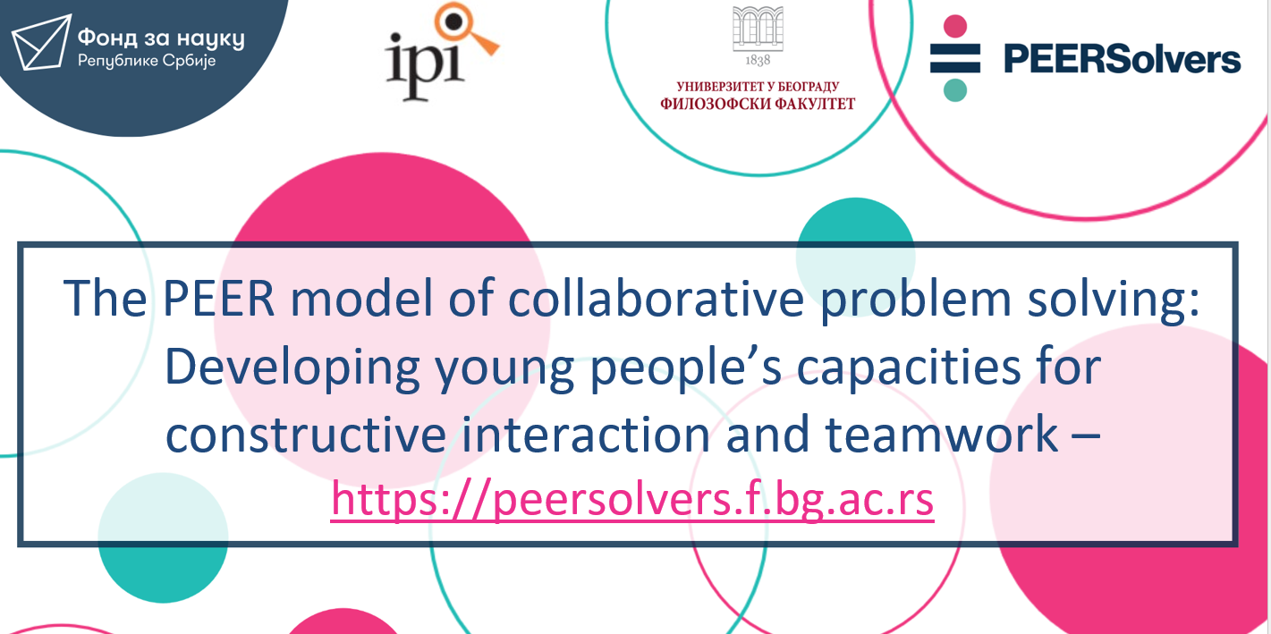
Ongoing research project: PEERSolvers
(funded by Science Fund of Republic of Serbia)

Slide 17

What makes peer collaborative problem solving (un)productive?
Qualitative systematic review: Educational Research Review (https://doi.org/10.1016/j.edurev.2023.100567 )
1. Six aspects of collaboration make a difference:
  socio-cognitive aspects
  socio-emotional aspects
  the quality of task/problem-solving strategies
  regulation of group activity oriented towards the task
  regulation of relationships between group members
  participant engagement in CPS
2. Productive collaboration is possible, but student need support to improve their capacity to establish and maintain a productive collaboration => development of PEER training

Slide 18
PEER training: 4 components
P – Personality: improving student understanding how different personalities can contribute to productive group collaboration and collaborative problem solving (CPS)
E – Exchange: improve capacities of students to establish a productive dialogues and discussion (socio-cognitive dimensions of collaboration)
E – Emotional intelligence: improve capacities of students to establish a productive socio-emotional relationships
R – Resources: improve capacities of students to use digital resources in a productive and responsible way

Slide 19
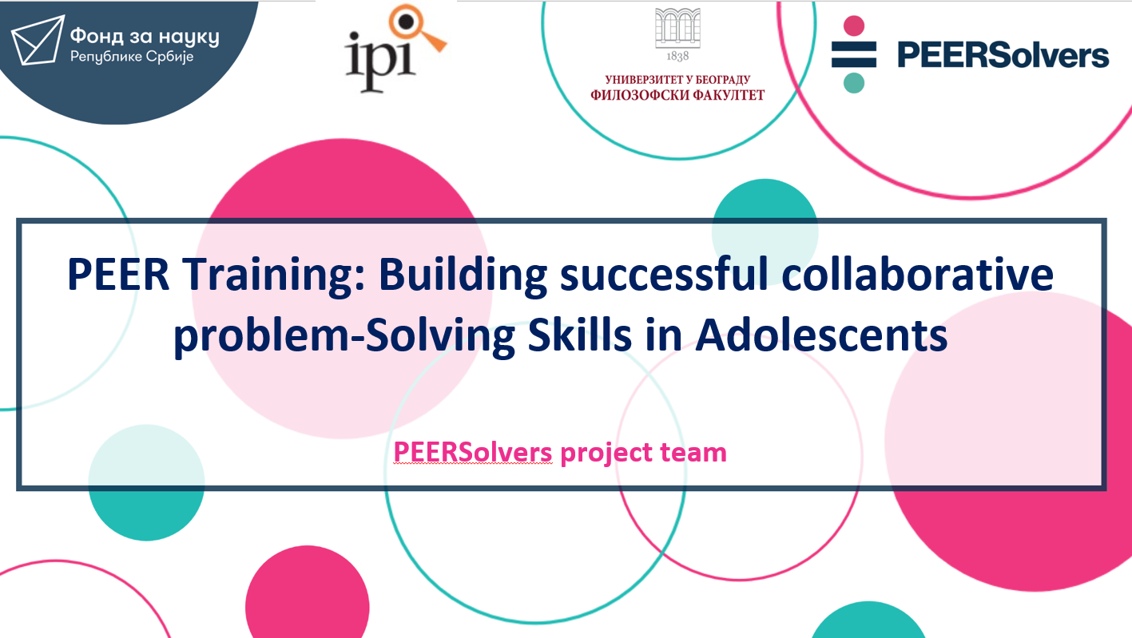
PEER training: an announcement
Day 2 (Thursday, 12th September, 11-12.30)
Room: Aula Leogrande 5A
SIG 10 invited symposium: Co-constructing meaning about teaching and learning: How to make research findings matter?

Slide 20
PEERSolvers: key findings of the Study 1 (in review)
RQ: Does PEER training has capacity to improve (a) quality of collaboration among upper secondary students and (b) quality of their proposed solutions for selected socio-scientific issues (ill defined issues relevant for students and society)
Key findings:
  PEER training improved quality of collaboration significantly (except for socio-emotional dimension that was close to the significant level)
  PEER training improved quality of proposed solutions for given socio-scientific issue
  Effect of PEER training on the quality of product is mediated completely by the socio-cognitive dimension, and partially by other dimensions

Slide 21
PEERSolvers: key findings of the Study 2 (in preparation)
RQ: Does PEER training has capacity to improve individual competences (science and civic) through improvement of quality of collaboration in joint reflection over complex science and civic items (borrowed from PISA and ICCS international studies)
Preliminary findings:
  Participation in the PEER training have a positive effect on posttest achievements of students on science and civic competences (the effect is lower for the civic competence)
  The effect of the PEER training on individual competences is mediated by improvement of the quality of collaboration among students (completely or partially)

Slide 22
Chilling move toward “hot” issues: peer interaction upon disputed historical narratives
Upper secondary students from two communities with history of conflicts (Muslim minority living in Serbia and Serbian community)
Students from two communities are invited to reflect upon disputed historical narratives on some mutual conflict and they get scaffolding provided by researcher (both with respect to productive collaboration and historical reasoning)
RQ: Would it be possible for students to establish a productive collaboration and to build a joint multi-perspective narrative? What kind of collaboration could enable students to distance themselves from “their” narratives (“truth”) and to jointly create a multi-perspective narrative?

Slide 23
Conclusions and reflections

Slide 24
Neverending story with increasing complexity
By time and after many research studies, we learn a lot, but … the number of open issues just increased as well as their complexity ☺
Moreover, it’s becoming clear that relationship between theory, research, and practice are more complex

Slide 25
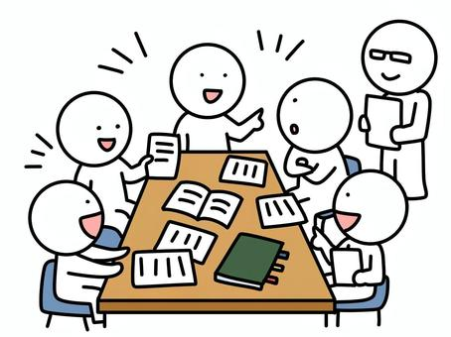
Increasing complexity
Actors
Task and its meaning
Context institutional
Context social and cultural
Context political
Tools and technologies
Objects
Identities
Relationships
Context personal
Motivation /Purposes
To be added…
Micro and macro time dimensions

Slide 26
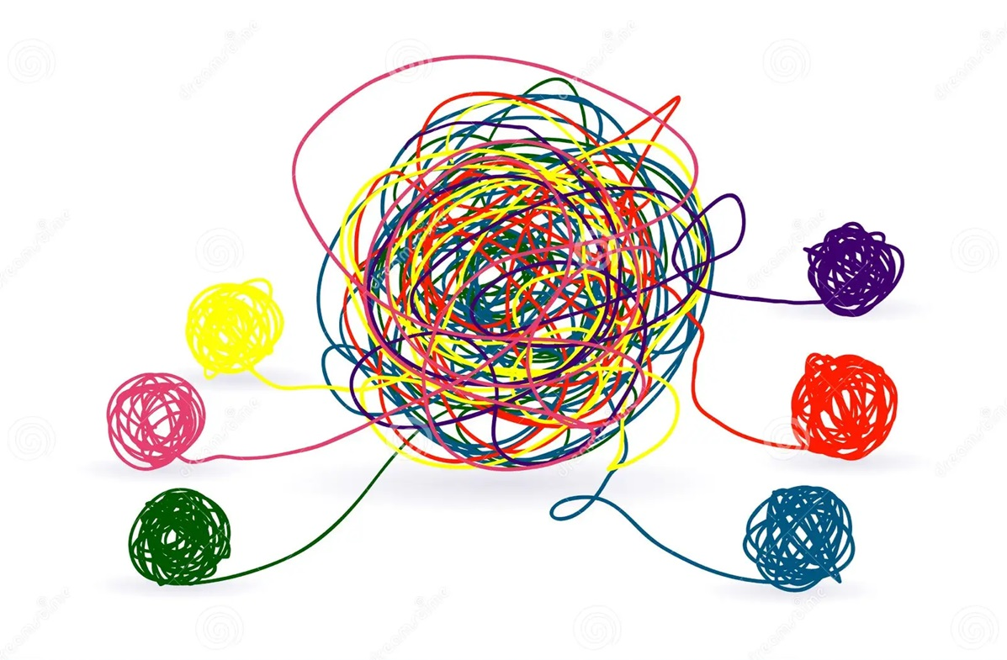
Increasing complexity
Actors
Context personal
Context institutional
Context social and cultural
Context political
Relationships
Tools
Purpose
Micro and macro time dimensions

Slide 27
Challenging future
Differentiation of the research field creates such big diversity => is it worth to treat this field of inquiry as а single research field?
Epistemological tensions: exploratory vs. analytic approach
Tensions between quantitative and qualitative approach
Challenges related with studying “hot” issues
Challenges related with implementation/enactment in the education and scaling up
  Challenges related with the dominant educational practices and context
  Challenges related with the dominant education policies
  Challenges with believes and values related to collaboration

Slide 28
Thank you for your attention!
Comments and questions

