Slide 1

PEER Training: Building successful collaborative problem-Solving Skills in Adolescents
PEERSolvers project team
This research was supported by the Science Fund of the Republic of Serbia, Grant No. 7744729, The PEER Model of Collaborative Problem Solving: Developing Young People’s Capacities for Constructive Interaction and Teamwork – PEERSolvers

Slide 2
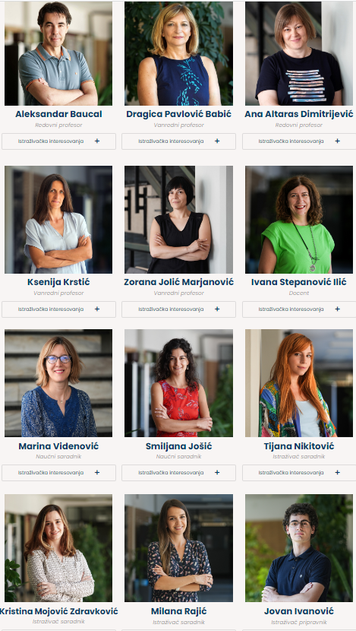
This research was supported by the Science Fund, Republic of Serbia, Grant No. 7744729,
Project title: The PEER model of collaborative problem solving: Developing young people’s capacities for constructive interaction and teamwork – PEERSolvers
https://peersolvers.f.bg.ac.rs
The project team:

Slide 3
The role of CPS
Collaborative problem solving (CPS) have been recognized as one of the important factors of cognitive development, but also as a key competence for the next generation in many societies!
Studies have shown that collaboration could yield more creative, effective, and comprehensive solutions and might be the only viable approach to solving some complex problems.
Studying collaboration among youngsters is relevant for the educational practice since it helps identify the conditions under which collaboration might be productive as well as the ways teachers could support students’ CPS in formal education.

Slide 4
Theoretical background
PEER model of collaborative problem solving
  Innovative, ecologically valid, and ready-to-use model for supporting the development of adolescents’ capacities for productive peer interaction and CPS
  based on the results of an analysis of extensive literature and empirical research findings
Personality: the relevance of the personality traits in determining team processes and performance
Exchange of ideas in collaboration: social rules, skills, values
Emotional intelligence: manage emotions
Resources available in collaboration: teacher scaffolding and digital media use

Slide 5
Training structure
Four main segments in the following order:
  Exchange - formulating and establishing rules for constructive dialogue and idea exchange
  Personality - recognizing and respecting personality and individual differences in teamwork
  Emotional intelligence - proper recognition, understanding and regulation of emotions during collaboration
  Resources - ability to use external resources, primarily digital data sources, to scaffold in problem-solving
Training duration: 4 days
Segment duration: 3 hours (2 x 90 minutes)
5-7 interactive activities per session
Evaluation in the last session

Slide 6
Training structure
Each session consisted of:
              presentation of the key concepts, principles, values, and guiding ideas relevant for self-regulation and group regulation in CPS,
              a set of group activities providing opportunities for application of acquired knowledge and skills in group collaboration
              session ending with a whole group reflecting upon experiences during the implementation of assigned activities

Slide 7
1. Exchange
Activity objectives:
familiarizing the youth with the rules of collaboration and the ways they ensure successful collaboration;
empowering the youth to understand the rules of successful collaboration;
supporting the youth in applying the rules of good collaboration and identifying the aspects of group functioning regulated by these rules.
Notes:
know/can explain the basic rules of good cooperation
understand how certain rules contribute to solving problems (e.g. monitoring progress, keeping track of time, arguing proposals), i.e. maintaining good relationships in the group (e.g. we are all equal and we respect each other)
recognize different types of violations/deviations from the rules of good cooperation and realize their negative consequences for the quality of interpersonal relations and/or solutions
know how to set and follow (some) rules of good cooperation in their own teamwork

Slide 8
1. Exchange – core activities
What is heard in a successful and what in an unsuccessful team?
Cards with statements that can be heard in teamwork
What are the rules of this?
Cards
Which rule does (not) apply here?
Comics
Fixing dialog
Vignettes
Can we apply some of these rules ourselves?
Trip planning task

Slide 9
Example
What is heard in…
Succesfull team | Unsucessfull team
Go ahead, we are listening carefully. | If something goes wrong, remember that I did not agree.
Let everyone say what they think about this suggestion. | You always fumble when you speak, so you’d better keep quiet.
I love you dearly, but I wouldn’t do it like that. | Let’s not dwell on it; just write down the first thing we come up with.
What do you think? You are good at this. | We have a plan and we should stick to it at all costs.
Do we all agree with this solution? | Wait, let me show you what I’ve found on TikTok.
Wait, this decision is not ok with everyone. | If you’re my friend, you’ll agree with me.

Slide 10
B1
C1
D1
CAR | LOTTERY | BEHAVIOR | NEWTON
CROSSROADS | JAMP ROPE | MANNERS | COURT
SIGNS | MONOPOLY | RESTAURANT | ATTORNEY
STOPLIGHT | VIDEO | DECORUM | ARTICLE
TRAFFIC | GAME | ETIQUETTE | LAW
RULES
A1
A2
B2
C2
D2
A3
B3
C3
D3
A4
B4
C4
D4
A
B
C
D
FINAL SOLUTION

Slide 11
2. Personality
Activity objectives:
familiarization with the concept and dimensions of personality;
improving the recognition of differences and similarities in personality traits;
enhancing the understanding of the roles of individual personality traits in collaboration;
practicing the identification of links between individual traits in a personality profile;
encouraging the application of knowledge about personality traits and the effect of personality on collaboration.
Notes:
After this segment it is expected that participants:
know the main personality traits ("big five") and their typical behavioral manifestations (in cooperation)
realize that each feature has certain advantages and disadvantages in cooperation
understand that the most optimal functioning of the group is achieved if the participation/role of each member is aligned with his personality profile
make an attempt to mitigate/prevent the negative or to strengthen the positive effects of certain personality traits in their own team

Slide 12
2. Personality – core activities
Personality in people
Imagining two close persons and writing down their qualities in interaction
Where am I, where are you in this dimension...
Adhesive tape and papers
What's your quality - that's your vibe
Cards with descriptions of behavior during cooperation
What character are you!?
Descriptions of fictitious persons (their personality profiles), profiles on the diagram
Does the like rejoice in the like, or is there beauty in diversity?
Role-play: assembly of tenants

Slide 13
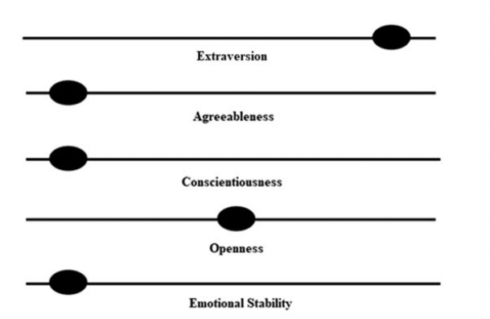
Example
Personality cards
Personality profiles
Maria has many friends and she is quite popular. At school, she has excellent grades, despite doing most of her schoolwork at the last minute due to poor time management. She often volunteers to express her opinion and all teachers know her name. When she prepares a project or presentation with oth - er students, Maria is always in charge. When solving tasks, she is highly curious and she can often devise multiple creative solutions. Other students sometimes find it challeng - ing to work with Maria because they per - ceive her as an obtrusive and impulsive per - son who occasionally seems dismissive of other people’s opinions.
HIGH AGREEABLENESS benefits | LOW AGREEABLENESS challenges
fosters good relations with team members | avoids arguing and rarely expresses an opposing opinion
easily reaches a compromise with others | tends to accept every majority decision without questioning it
makes other group members fee accepted i | due to focusing on relations, can make a poorer contribution to solving the task
cooperator | team player

Slide 14
3. Emotional inteligence
Activity objectives:
fostering emotion perception skills;
fostering skills of using emotions;
consolidating and enriching the emotional vocabulary;
fostering emotion understanding skills;
fostering emotion management skills.
Notes:
After this segment it is expected that participants:
can adequately name, differentiate and categorize several shades of basic emotions
understand the importance, possible causes and consequences of emotions in team group work (in which situations, what emotions occur and what outcomes it can have)
realize that different people have different perspectives and different emotional experiences of the same situation and that the same situation can have different outcomes depending on the emotional reaction
know different ways of regulating emotions during teamwork and distinguish between them with regard to their adaptability/constructivity

Slide 15
3. Emotional inteligence – core activities
A Hundred Faces – One Emotion and Vice Versa
Photos of nonverbal/facial expression of emotions
In the Mood for Different Moods
Several versions of the mood/emotion coordinate system
Emotional Nuances
Cards with the labels of the basic emotions, statements with boldface words and phrases denoting different “nuances” of the basic emotions
Emotion Puzzles - Solving
Emotion puzzle template
Emotion Puzzles - Fixing
Emotion puzzle template

Slide 16
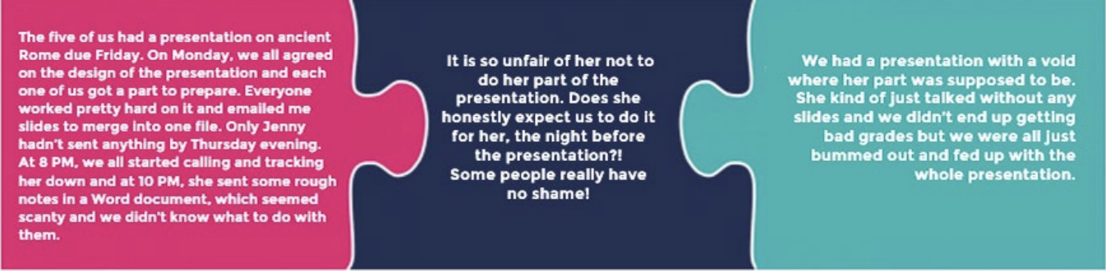
Example
Emotion Puzzle

Slide 17
4. Resources
Activity objectives:
supporting the youth in devising and selecting effective internet search strategies;
fostering a critical attitude towards the information available online, especially in terms of its reliability;
expanding the knowledge offered by the internet as a meta-source of information: internet searching and chatbots.

Slide 18
4. Resources – core activities
What (all) can be resources when solving a problem?
Resources in my head
Internet as a source of information: how do we search?
Critical attitude towards information: "Fake news"
Critical attitude towards information: References and ChatGPT
Searching for relevant sources

Slide 19
Training implementation
Participants:
  second-year students from six Belgrade high schools (3 gymnasium and 3 vocational schoolsvocational)
  approximately 21 students per group, 123 students total
  67 (54.5%) were girls and 71 (57.7%) attendees of general (grammar) school
Training took place over four days
Sessions lasting three or four hours each
Trainer impressions and evaluation results:
  The training can be successfully carried out according to the intended scenario
  Student ratings of content relevance: 3.39–3.58 (on a scale of 1–4)
  Student ratings of their own competence after the turn: 3.61–3.80 (on a scale of 1 to 4)

Slide 20
Conclusion
Current education does not provide adequate opportunities for the development of CPS competences
Why PEER training?
  It follows a simple structure - every teacher can do it
  It can be easily implemented in educational setting
  It can be modified to become a part of regular school lessons
  It can be done both in formal and informal context

Slide 21
THANK YOU FOR YOUR ATTENTION!
Learn more about the training and project at
https://peersolvers.f.bg.ac.rs/

